Slide 1

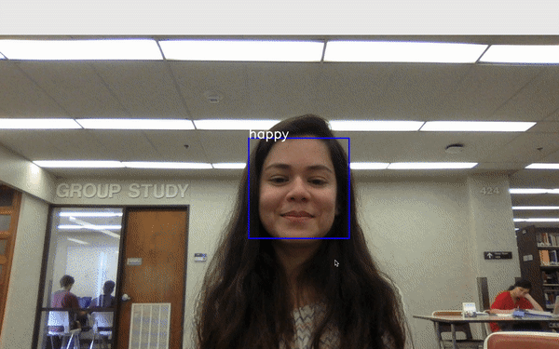

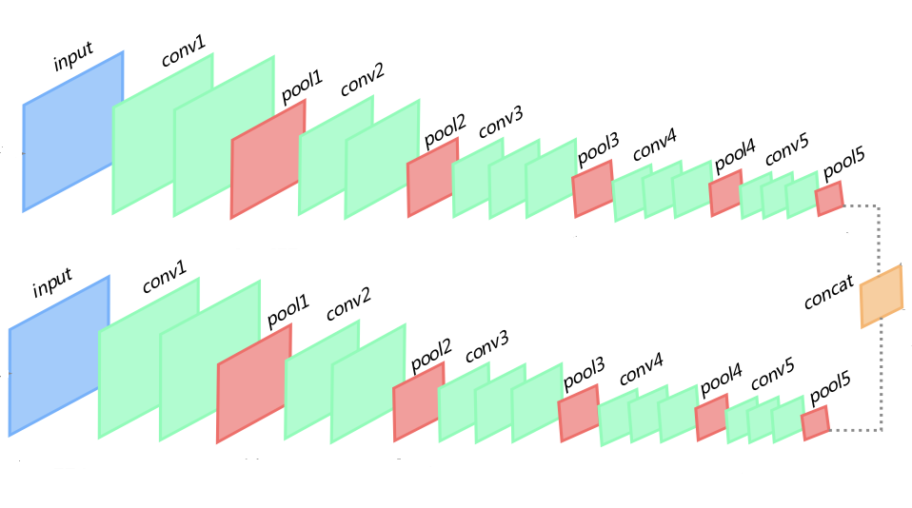

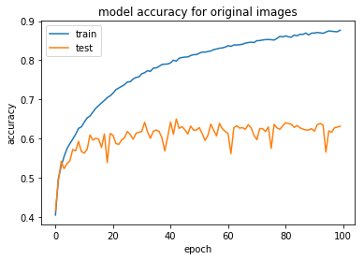
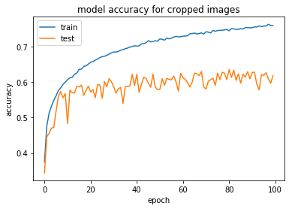

FaceZam : ShaZam your Face!
Ensemble-CNN model for facial emotion recognition on FER2013 and a comparative study with a Random Forest Classifier.
Akshaye AP, Atreye Ghosh, Jithin Thomas, Varsha Khanna {akshayeap, jithinjosethomas, aghosh32, vkhanna92}@tamu.edu
Title: Subtitle
MAIN IDEA
Trained 2 CNN models. First on original pixels , Second on the cropped images using haar-cascade filter.
Ensemble : Combined the above two models using weight sharing.
Comparative study with Random Forest Classifier trained using facial landmark features.
Built a real-time system to detect faces from a video feed and continuously classify them using our model, demonstrating the ability to transfer skills learned on the static datasets.
Original Image
RESULTS
Cropped Image
MODEL | ACCURACY
_{SVM + PCA} _{[Baseline]} | 39.90%
Random Forest [dlib] | 50.2%
CNN [Original dataset] | 63.88%
CNN [Haar-cascade] | 60.75%
FaceZam! | 65.23%
Figure 2. The architecture of our CNN model. Each convolution layer is equipped with a ReLU activation function.Dropout is used after the fully-connected layer to prevent overfitting
REFERANCE [1]Anjana R., Lavanya M. “Facial Emotions Recognition System For Autism” International Journal of Advanced Engineering Technology -June,2014 /40-43 [2] F. Bourel, C.C. Chibelushi, A.A. Low, "Robust Facial Expression Recognition Using a State-Based Model of Spatially-Localised Facial Dynamics", Proc. Fifth IEEE Int. Conf. Automatic Face and Gesture Recognition, pp. 106-111, 2002 [3] F. Bourel, Models of Spatially-Localised Facial Dynamics for Robust Expression Recognition, Ph.D. Thesis, Staffordshire University, 2002 [4] V. Bruce, "What the Human Face Tells the Human Mind: Some Challenges for the Robot-Human Interface", Proc. IEEE Int. Workshop Robot and Human Communication, pp. 44-51, 1992

